Slide 1
Heart diagnosis analysis

Slide 2
Introduction :
Initially, loading the dataset in the jupyter notebook and importing the libraries (numpy,pandas,matplotlib,searborn.)
Cells are likely to provide a project’s objective, tackling on analyzing crop production data.
After importing , code cells read the csv file after loading crop production data.

Slide 3
Details of dataset performance
Data loading
Data cleaning
Exploratory data analysis
Statistical analysis
Modelling

Slide 4
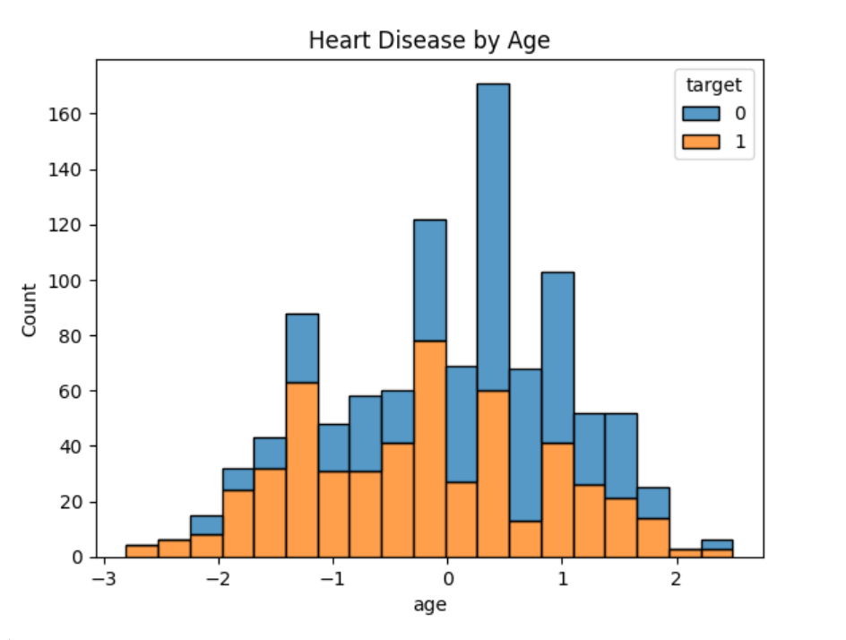
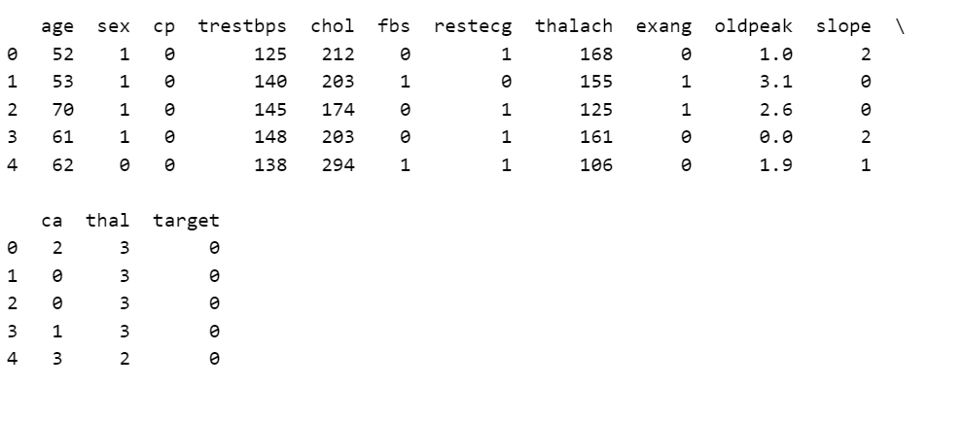
output

Slide 5
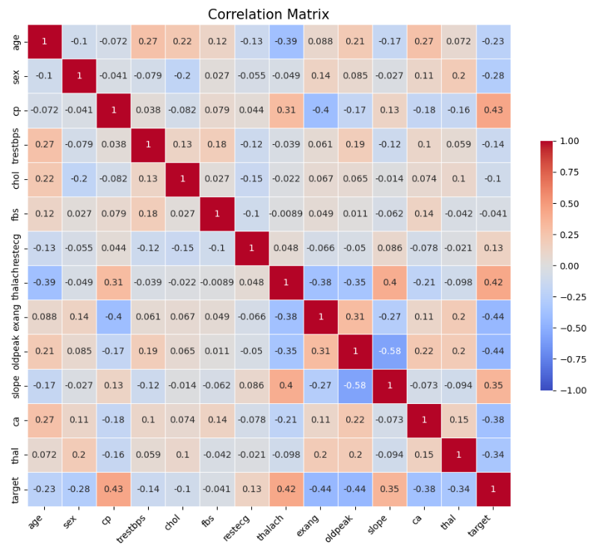
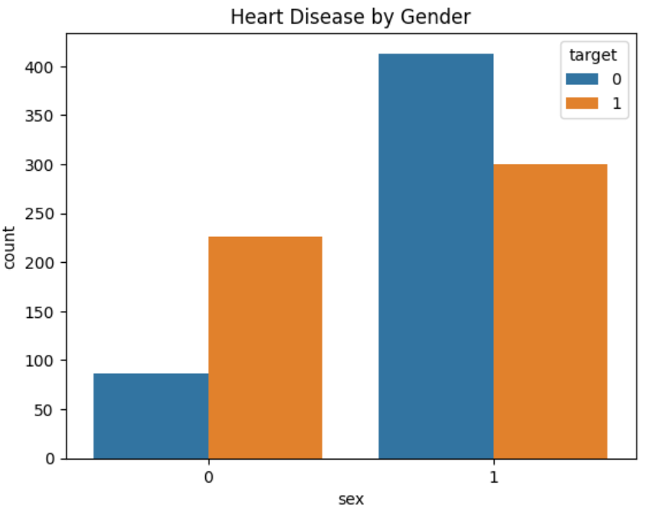
output

Slide 6
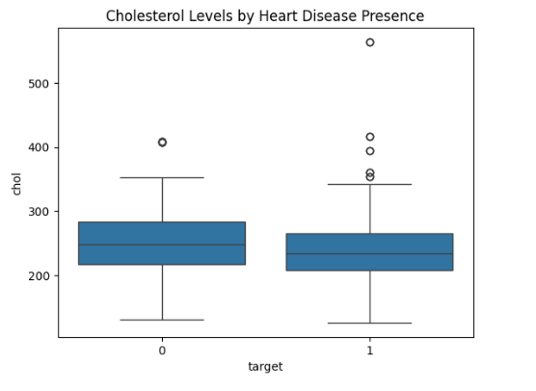
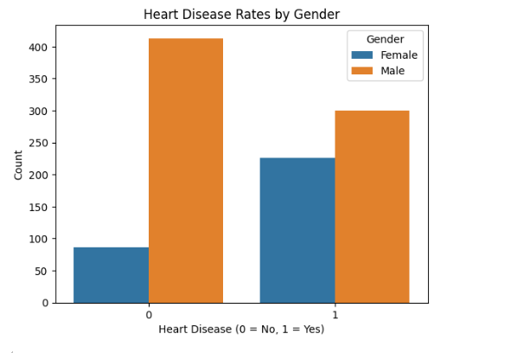
output

Slide 7
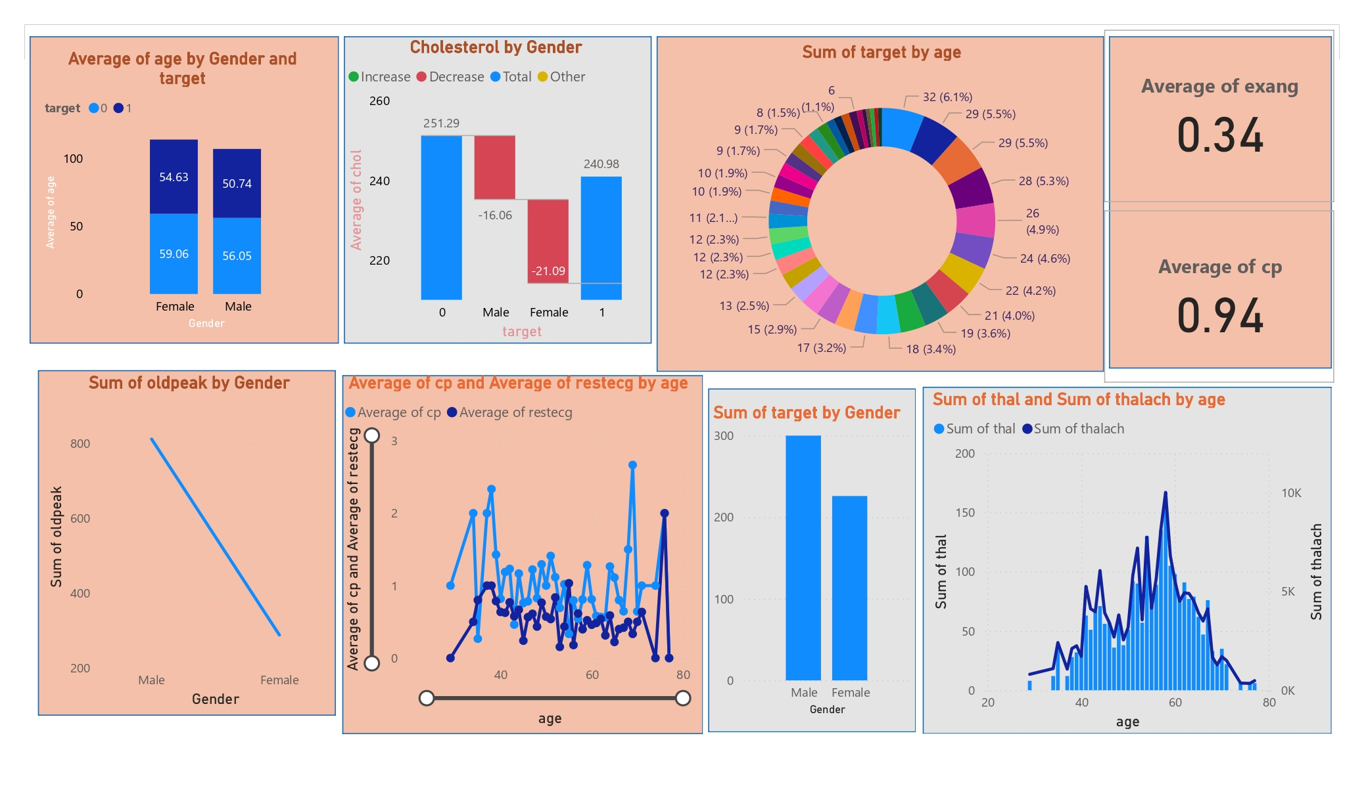
output

Slide 8
overview
Libraries Import:
Import necessary libraries: numpy, pandas, matplotlib, seaborn, and scikit-learn.
Data Loading and Preprocessing:
Load the 'Heart Disease data.csv' file into a DataFrame.
Drop rows with missing values.
Normalize the 'age' column.
Exploratory Data Analysis:
Calculate and print the overall heart disease rate.
Visualize heart disease distribution by gender using a count plot.
Visualize heart disease distribution by age using a histogram.
Calculate and display the correlation matrix with a heatmap.
Data Saving:
Save the cleaned DataFrame to 'cleaned_heart_disease_data.csv'.
Additional Analysis:
Calculate and print the mean age of patients with heart disease.
Visualize cholesterol levels by heart disease presence using a boxplot.
Visualize heart disease rates by gender using a count plot with customized labels.

Slide 9
THANK YOU

